Slide 1



Using Telematics Data Analytics to Plan for Fleet Electrification
Wednesday, May 20, 2026
Notes:
April: Housekeeping
Series IntroThanks for joining us today for the Sustainable Fleet Technology Webinar Series! Our topic today is First Responder Fleet Efficiency & Vehicle Options, and we have some great presenters. If you’re not familiar with the SFT Webinar series, we have 6 sessions this year. Stay tuned to the end to see the additional topics.
With these informative sessions we recruit industry experts who analyze frequent challenges, demonstrate areas of potential operational and environmental improvement, and showcase strategies and technologies fleets are implementing to drive their sustainability goals. We don’t just cover electric vehicles in these sessions. We’re fuel agnostic - so as long as the fuel or technology results in cleaner transportation, resiliency, or sustainable business practices for fleets, both public and private - we want to provide that information. Registration is free for all SFT webinars.

Slide 2


Slide 3
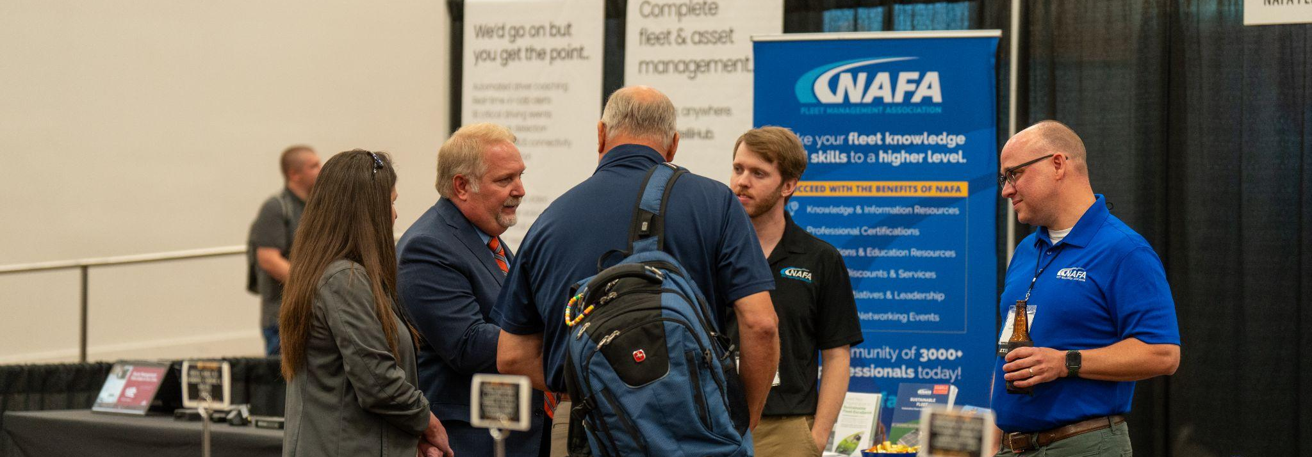

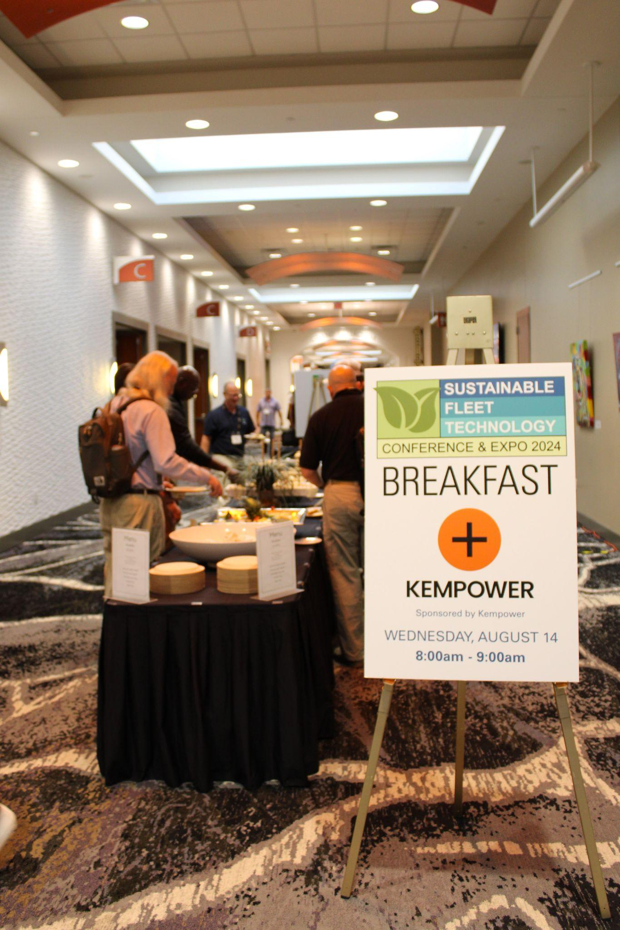
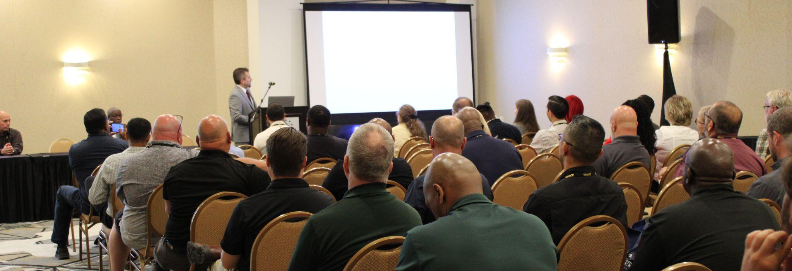

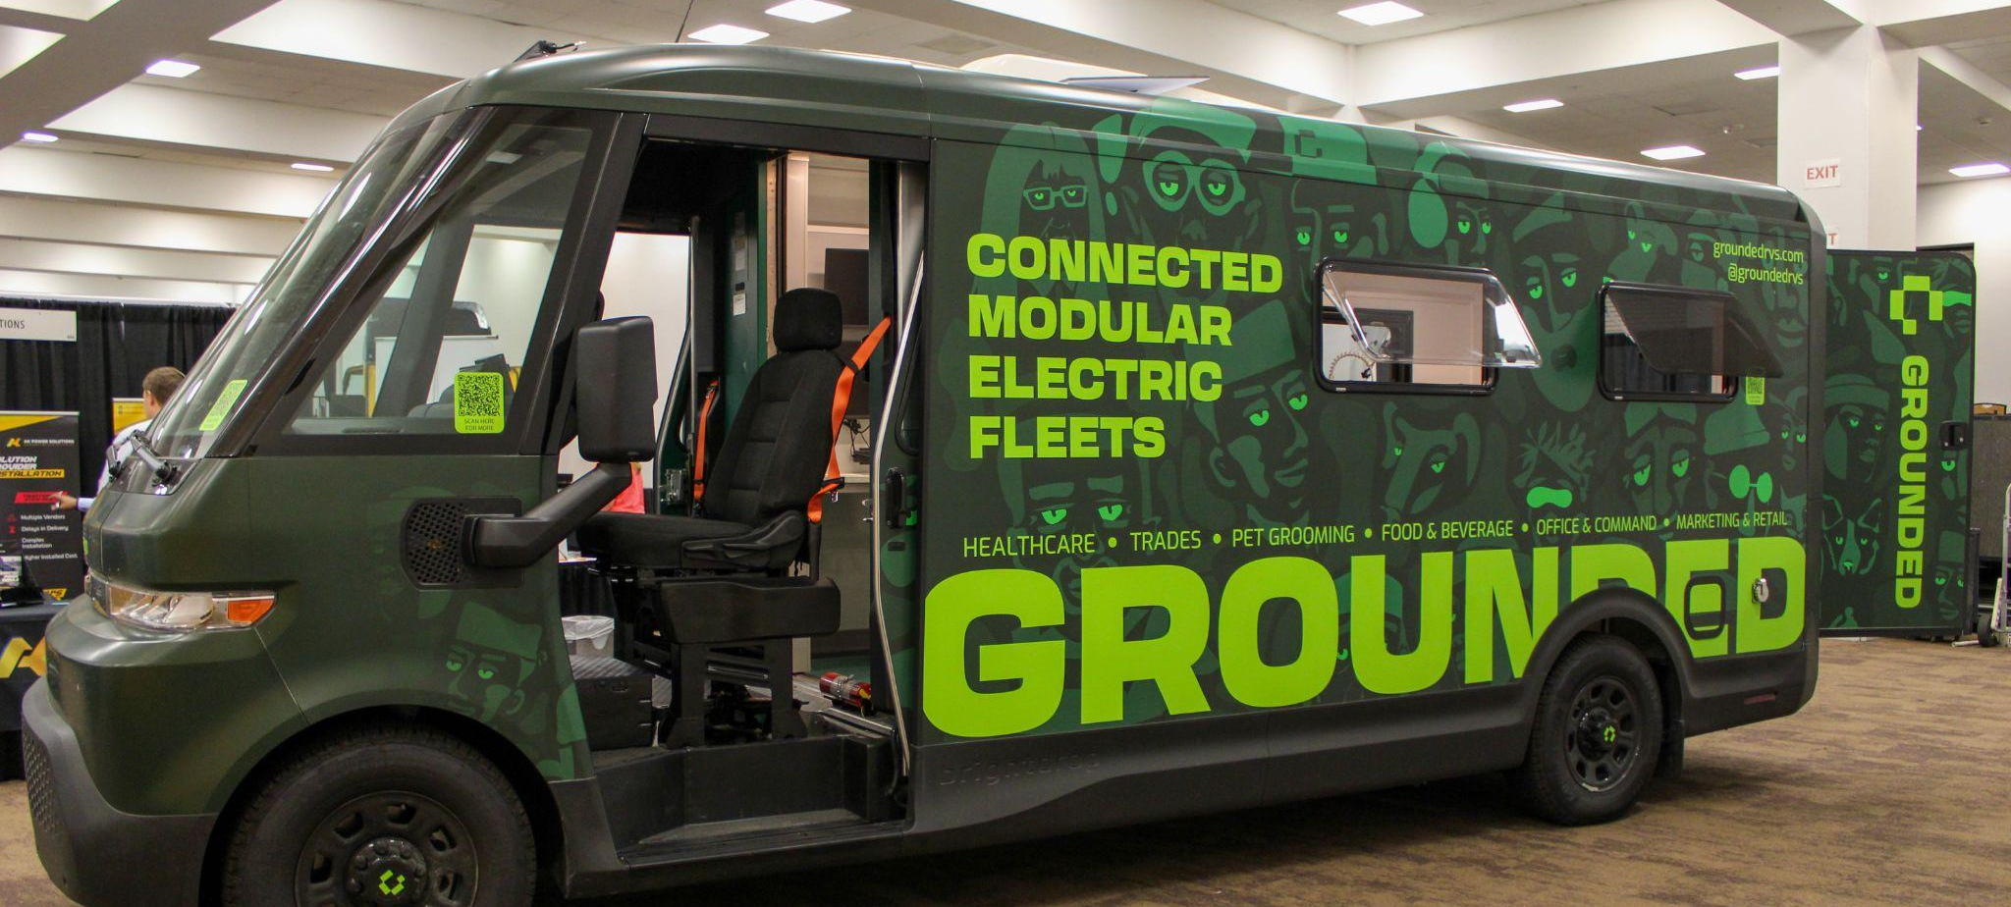

Notes:
SFT Conference:
Mainstage: Speakers from International Companies
Expo Hall: Full of Products & Services to expand opportunities to interact with companies with options for extending sustainable technologies and efficiencies of fleets. Great for public and private fleets - it’s also great for sustainability managers and the early bird registration is only $349.

Slide 4
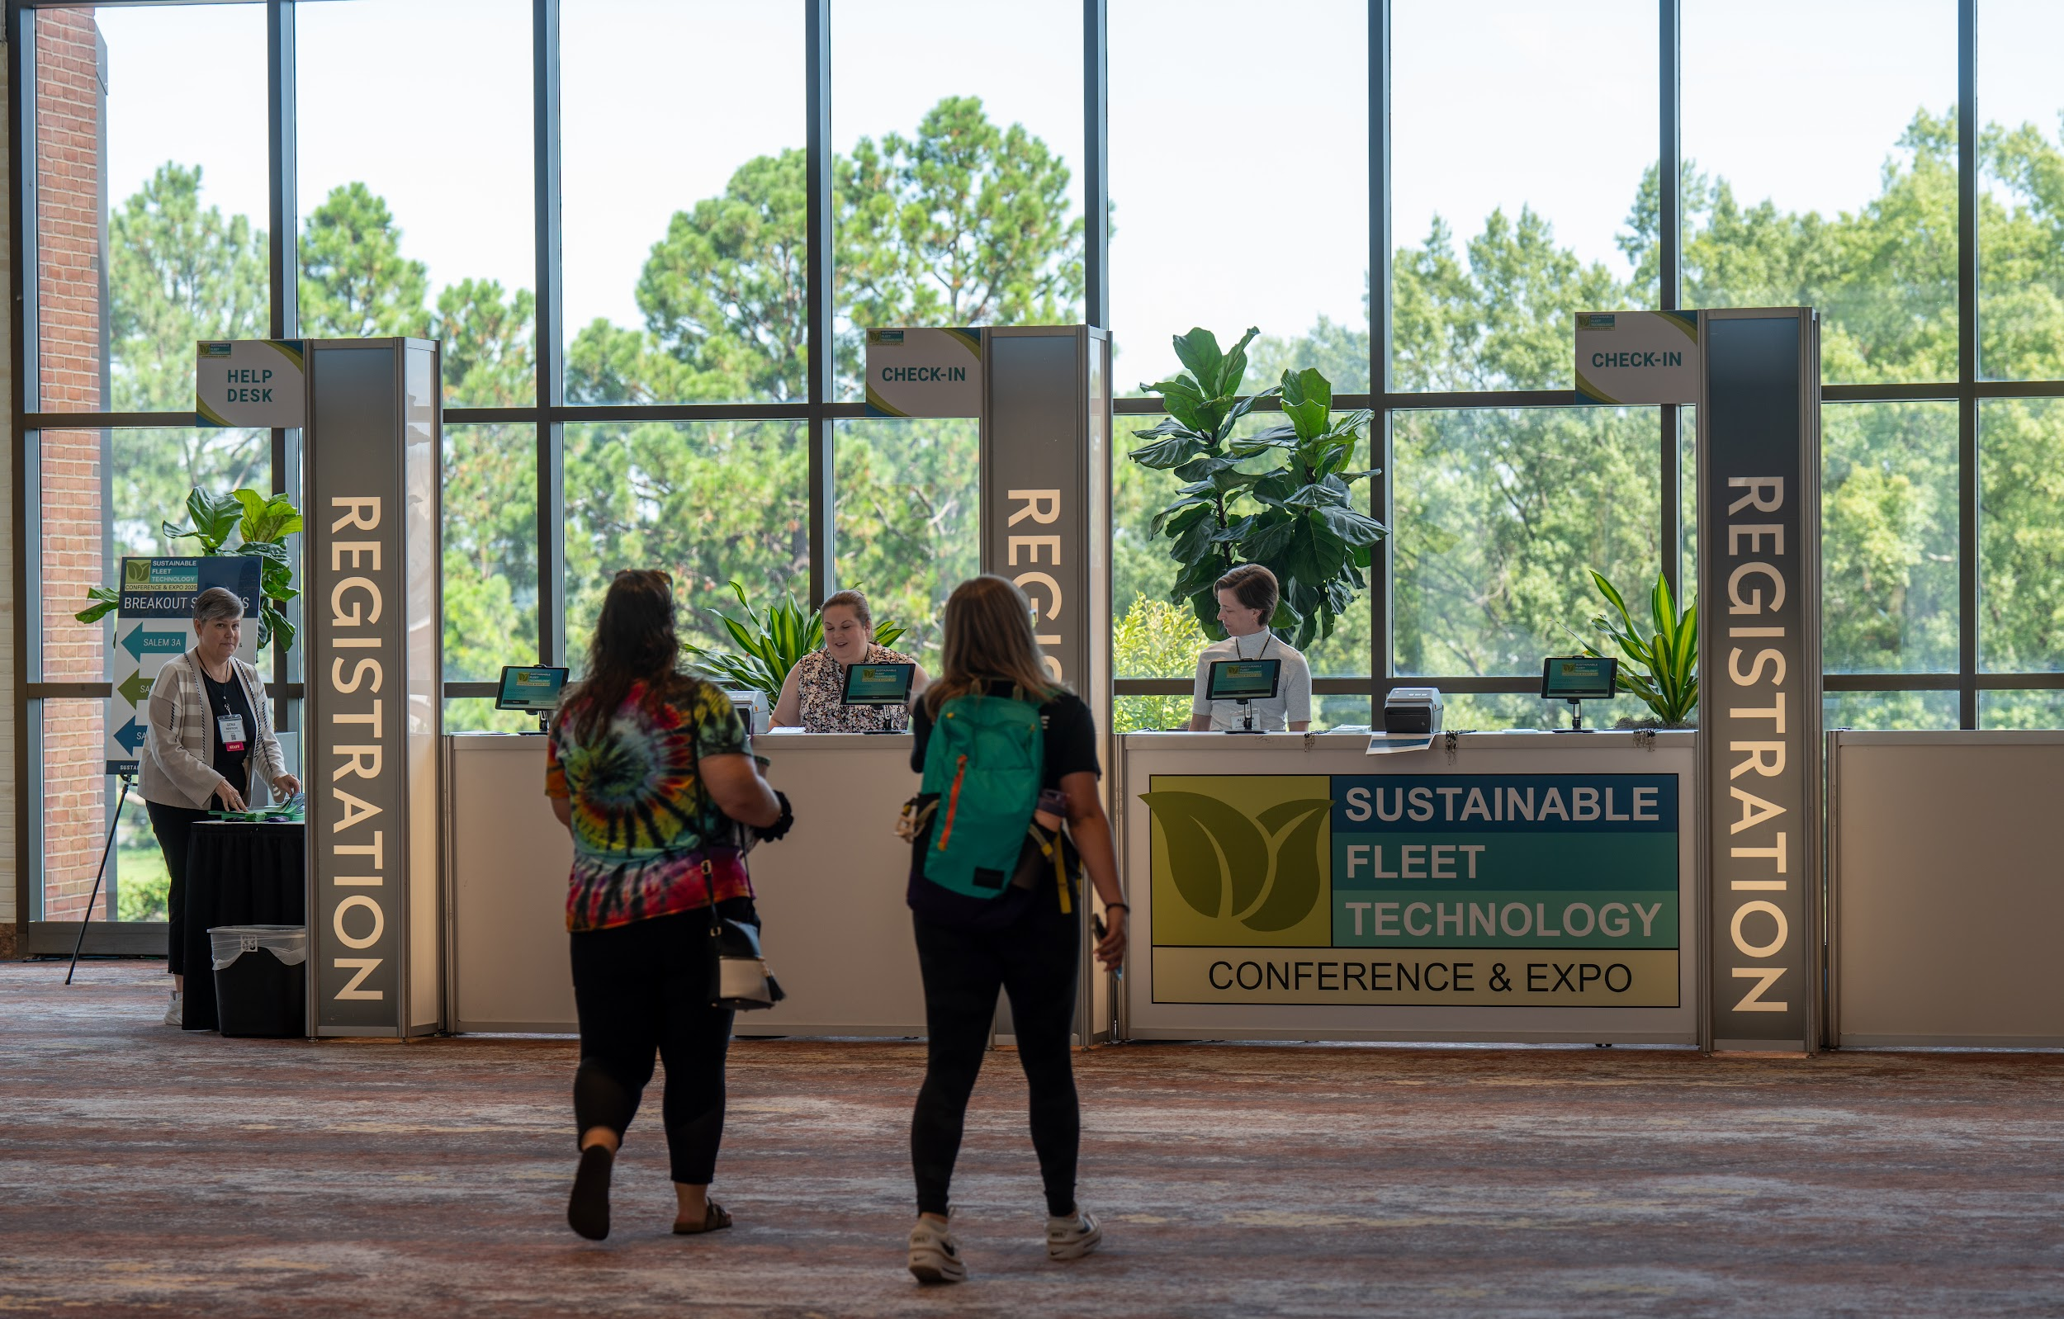
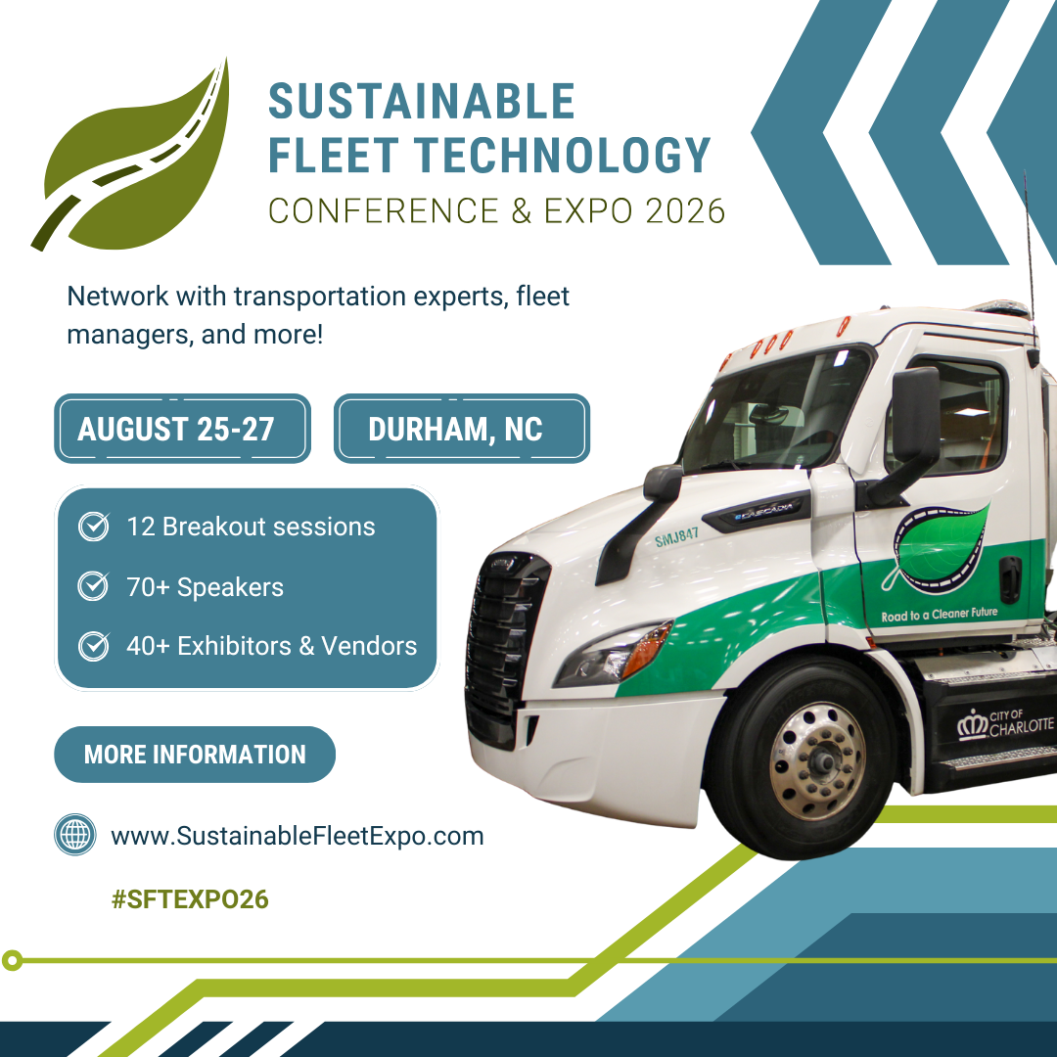
Join us!
www.sustainablefleetexpo.com
Notes:
Slide 6: The call for topics is open, and we want to know what you want to know. No matter if you’ve been in fleet or sustainability or even human resources or leadership who influences purchasing decisions, this is a place for you to learn and network. Visit sustainablefleetexpo.com to complete the Call for Topics form - you can recommend speakers as well. It’s a short form. We’re not asking for a dissertation, just your ideas. Sponsorships and Exhibitor opportunities are still available - we sold out last time we were in Durham, so please reach out about those opportunities or to join as a sponsor of this webinar series.

Slide 5
Using Telematics Data Analytics to Plan for Fleet Electrification
Wednesday, May 20, 2026

Slide 6



Today’s Speakers
Jared Walker
Sr. Specialist, EV Product Analytics
Sawatch Labs, A WEX Company
Katie Fletcher
Sustainability Program Analyst
Denver Water
Ronald Wirth
Fleet Advance Planning and Sustainability Manager
County of Sacramento, Fleet Services Division

Slide 7


Sawatch Labs
A WEX Company
Using Telematics Data Analytics to Plan for Fleet Electrification
Notes:
To kick us off, we have

Slide 8

About Sawatch Labs
1B+
miles analyzed
100M
trips accessed
~$600M
savings potential
~6M
annual GHG reduction (tons)
Founded in 2017
  Acquired by WEX in May 2024
  Fleet electrification analysis
  Emissions reporting
  Trusted by 200+ fleets
Deep expertise in
  Energy modeling
  Duty cycle characterization
  Telematics & Operational Data
  Big data
Neutral advisor
  State & Municipal Fleets
  Universities & School Districts
  Fortune 50
  Utilities, Engineering, Consulting Firms
*Estimates based on internal data as of January 2023.
Proprietary & Confidential

Slide 9
The Power of Telematics Data
Digital Twin Integration:
High-resolution duty cycle analysis. Validate range suitability against terrain, payload, and ambient temperatures.
Operational Confidence:
Predictive modeling factors in climate, terrain, and payload to remove "range anxiety" from the driver equation.
Data Driven EVSE Planning:
Optimize chargers using real dwell patterns.
Match charging power to actual dwell data.

Slide 10




Telematics Driven Sawatch Labs Apps
EV Feasibility
Site-Specific Infrastructure Planning
Active ROI Management
Emissions Tracking

Slide 11




Not All Miles Are The Same
How much energy is required to drive those miles?
Ambient Temperature
Topography
Driving behavior
Load
Auxiliary demands
Advertised
230 mi
Actual
190 mi

Slide 12
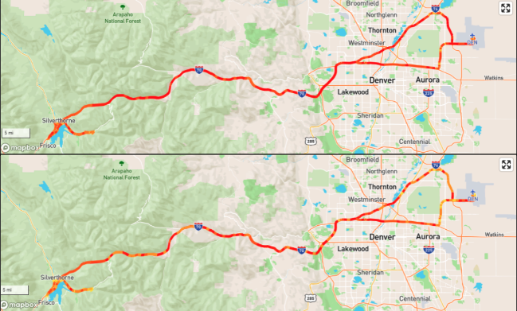
Advanced Energy Modeling with Telematics Data
Diesel
kWh
Proprietary & Confidential

Slide 13
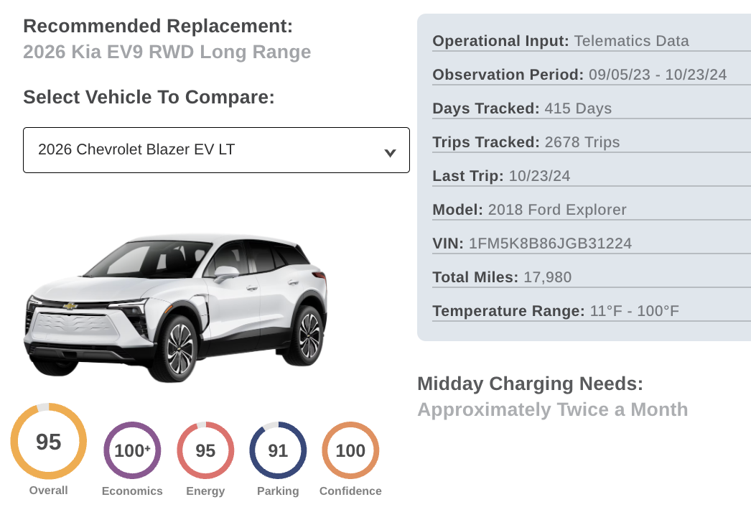

Using Telematics Data to Build a Mixed-Energy Fleet
Vehicle-specific recommendations:
Operational impact
Dynamic results
Localized
Classes 1-8
Driving and dwell behavior
Charging needs

Slide 14
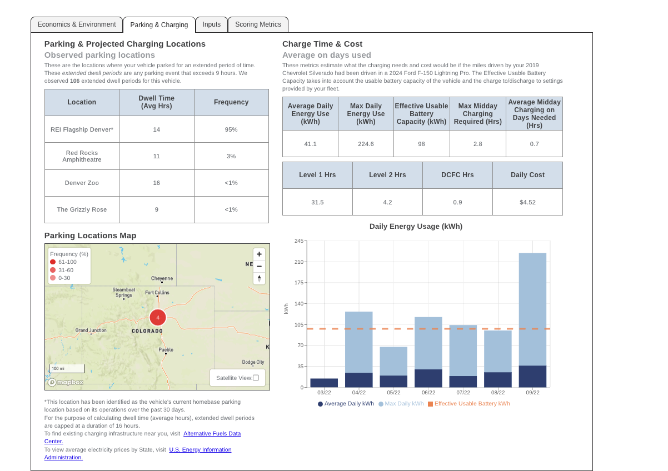
Vehicle Specific Charging Projections

Slide 15
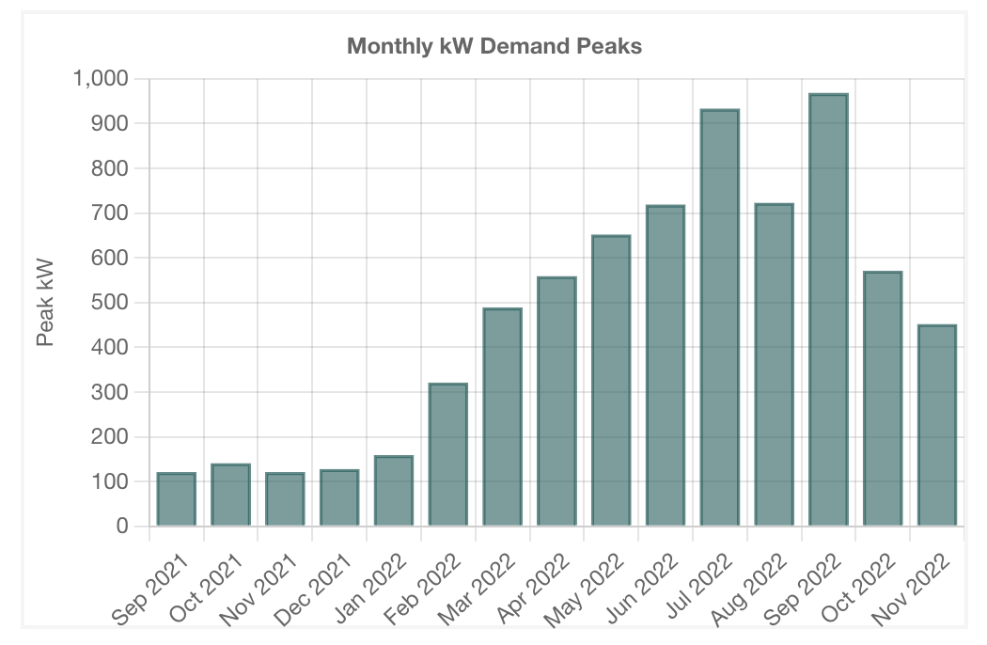
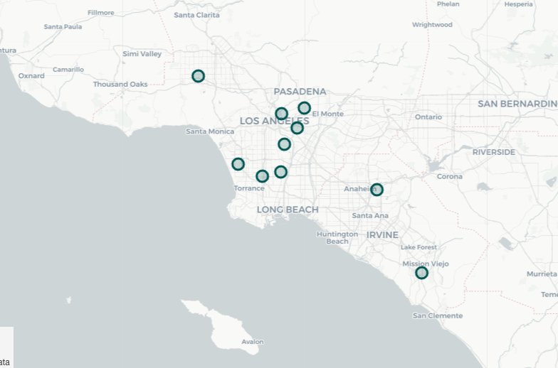
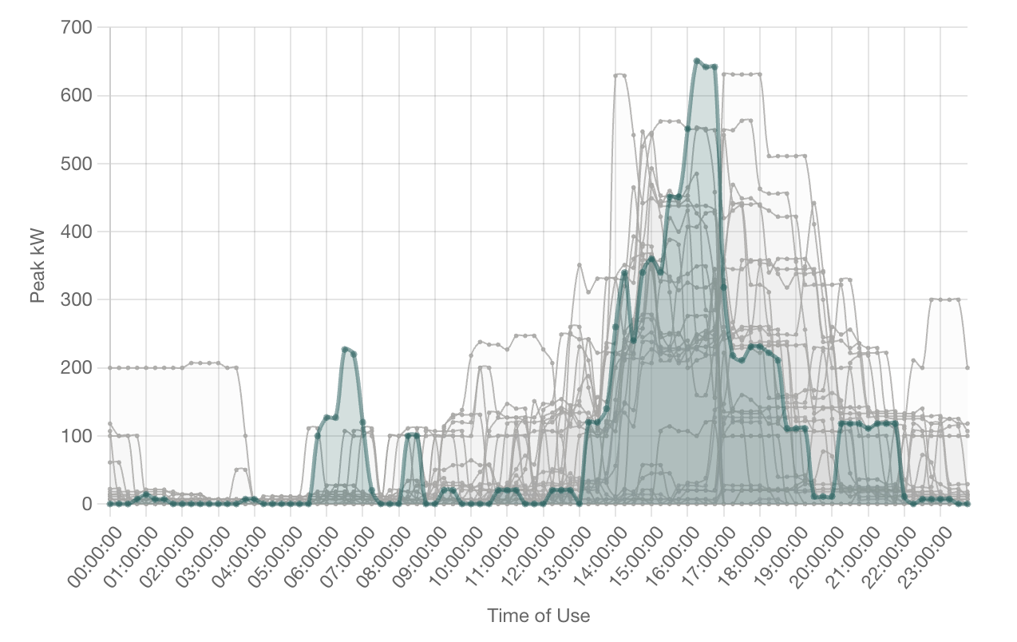
Telematics Based Recommendations for Optimized EVSE planning
Projects where, when and how long vehicles will charge
Future-proof (5-100% electrification targets)
Daily demand curves for fleet-wide projected charging
Unmanaged and managed charging scenarios

Slide 16
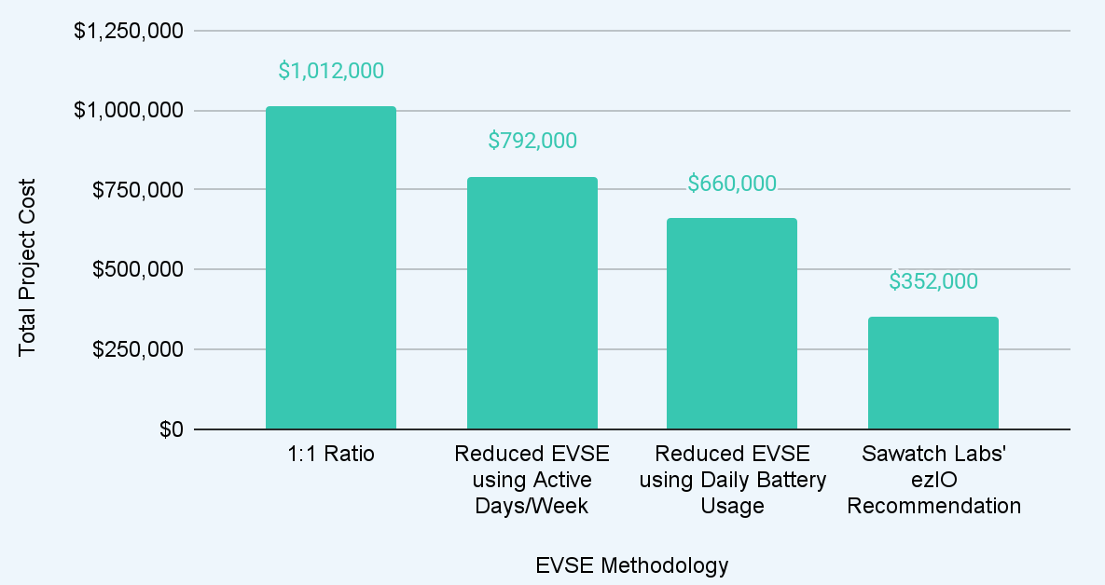
EVSE Strategy Cost Comparison
Potential Savings
$660k
-22%
-35%
-65%

Slide 17
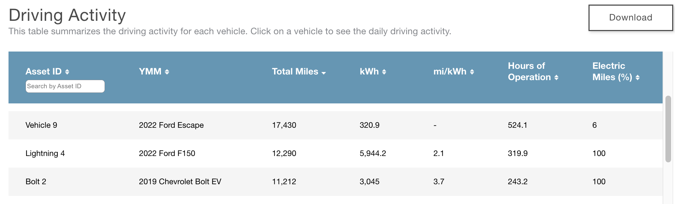
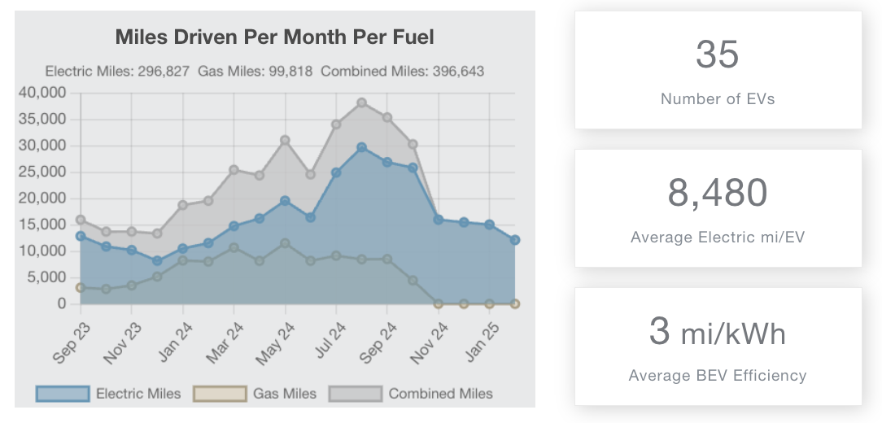
ionEV: Optimizing Existing EVs and PHEVs
Active Management of EVs and PHEVs

Slide 18
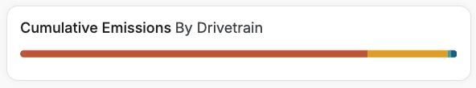
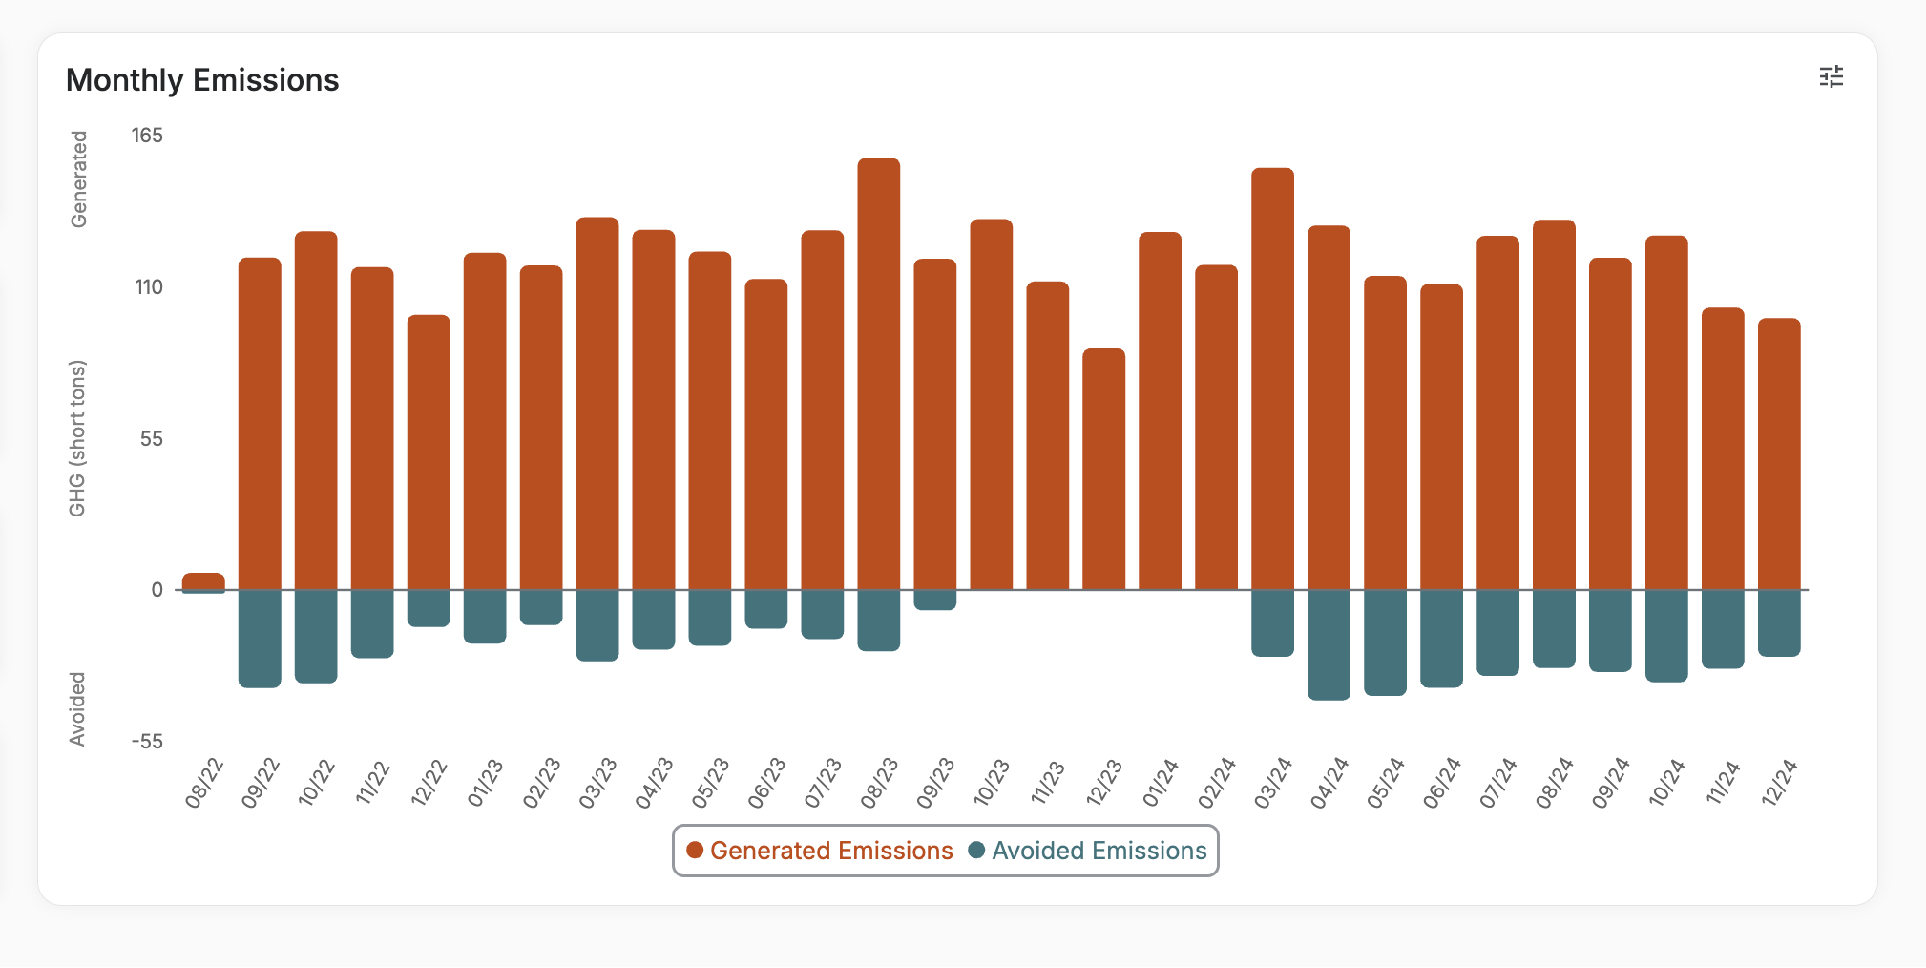
Fleet Emissions Reporting
Generated GHG Emissions
3,437 tons
Total Fuel Reduction
60,744 gals
Avoided GHG Emissions
585 tons
Total Fuel Savings
$174,000
Granular emissions data
Automated monthly compliance reports
Track progress towards sustainability goals
Easy-to-use, online dashboard

Slide 19
Jared Walker
Sr. Specialist, EV Product Analytics
jared.walker@wexinc.com

Slide 20
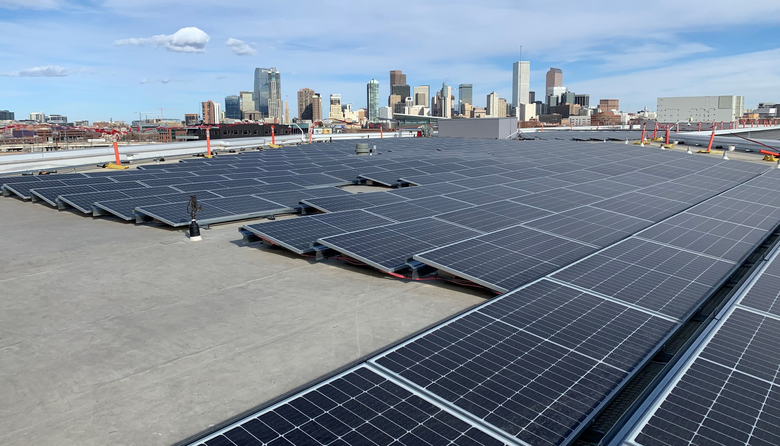

Fleet Electrification at Denver Water
May 20, 2026

Slide 21
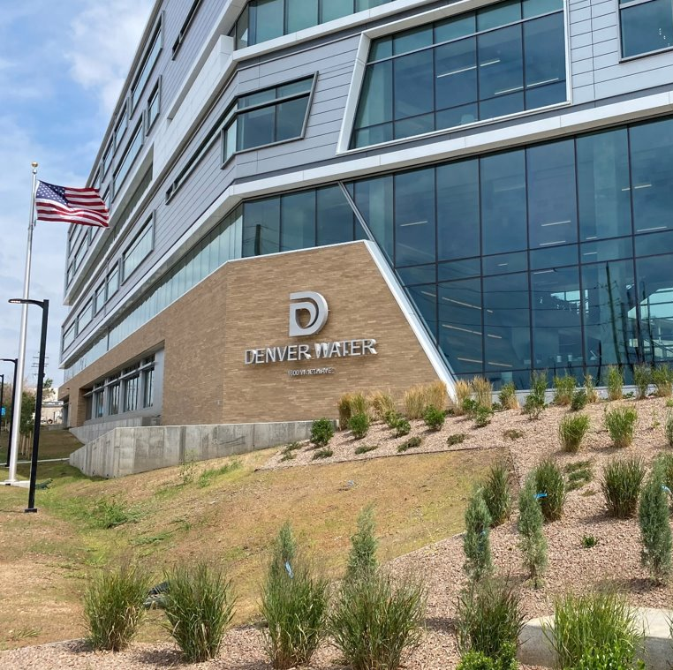
Denver Water Background
Denver Water serves 1.5 million people in the Front Range of Colorado (25% of the state's population) using less than 2% of water used in the state.
We operate out of 12 counties in Colorado, have a total watershed area of 4,000 square miles and 3,000 miles of pipe in our system. All of this creates a lot of operational complexity.
Approximately 1,100 employees all over the state.
Huge variety in job functions, weather conditions, and requirements for vehicles.

Slide 22



Fleet Sustainability Goals & Commitments
Achieve net-zero carbon emissions by the end of 2030.
Replace all SUVs and light-duty vehicles with electric or alternative-fuel vehicles by 2029.
Consider alternative-fuel vehicles to replace large equipment as technology improves.

Slide 23
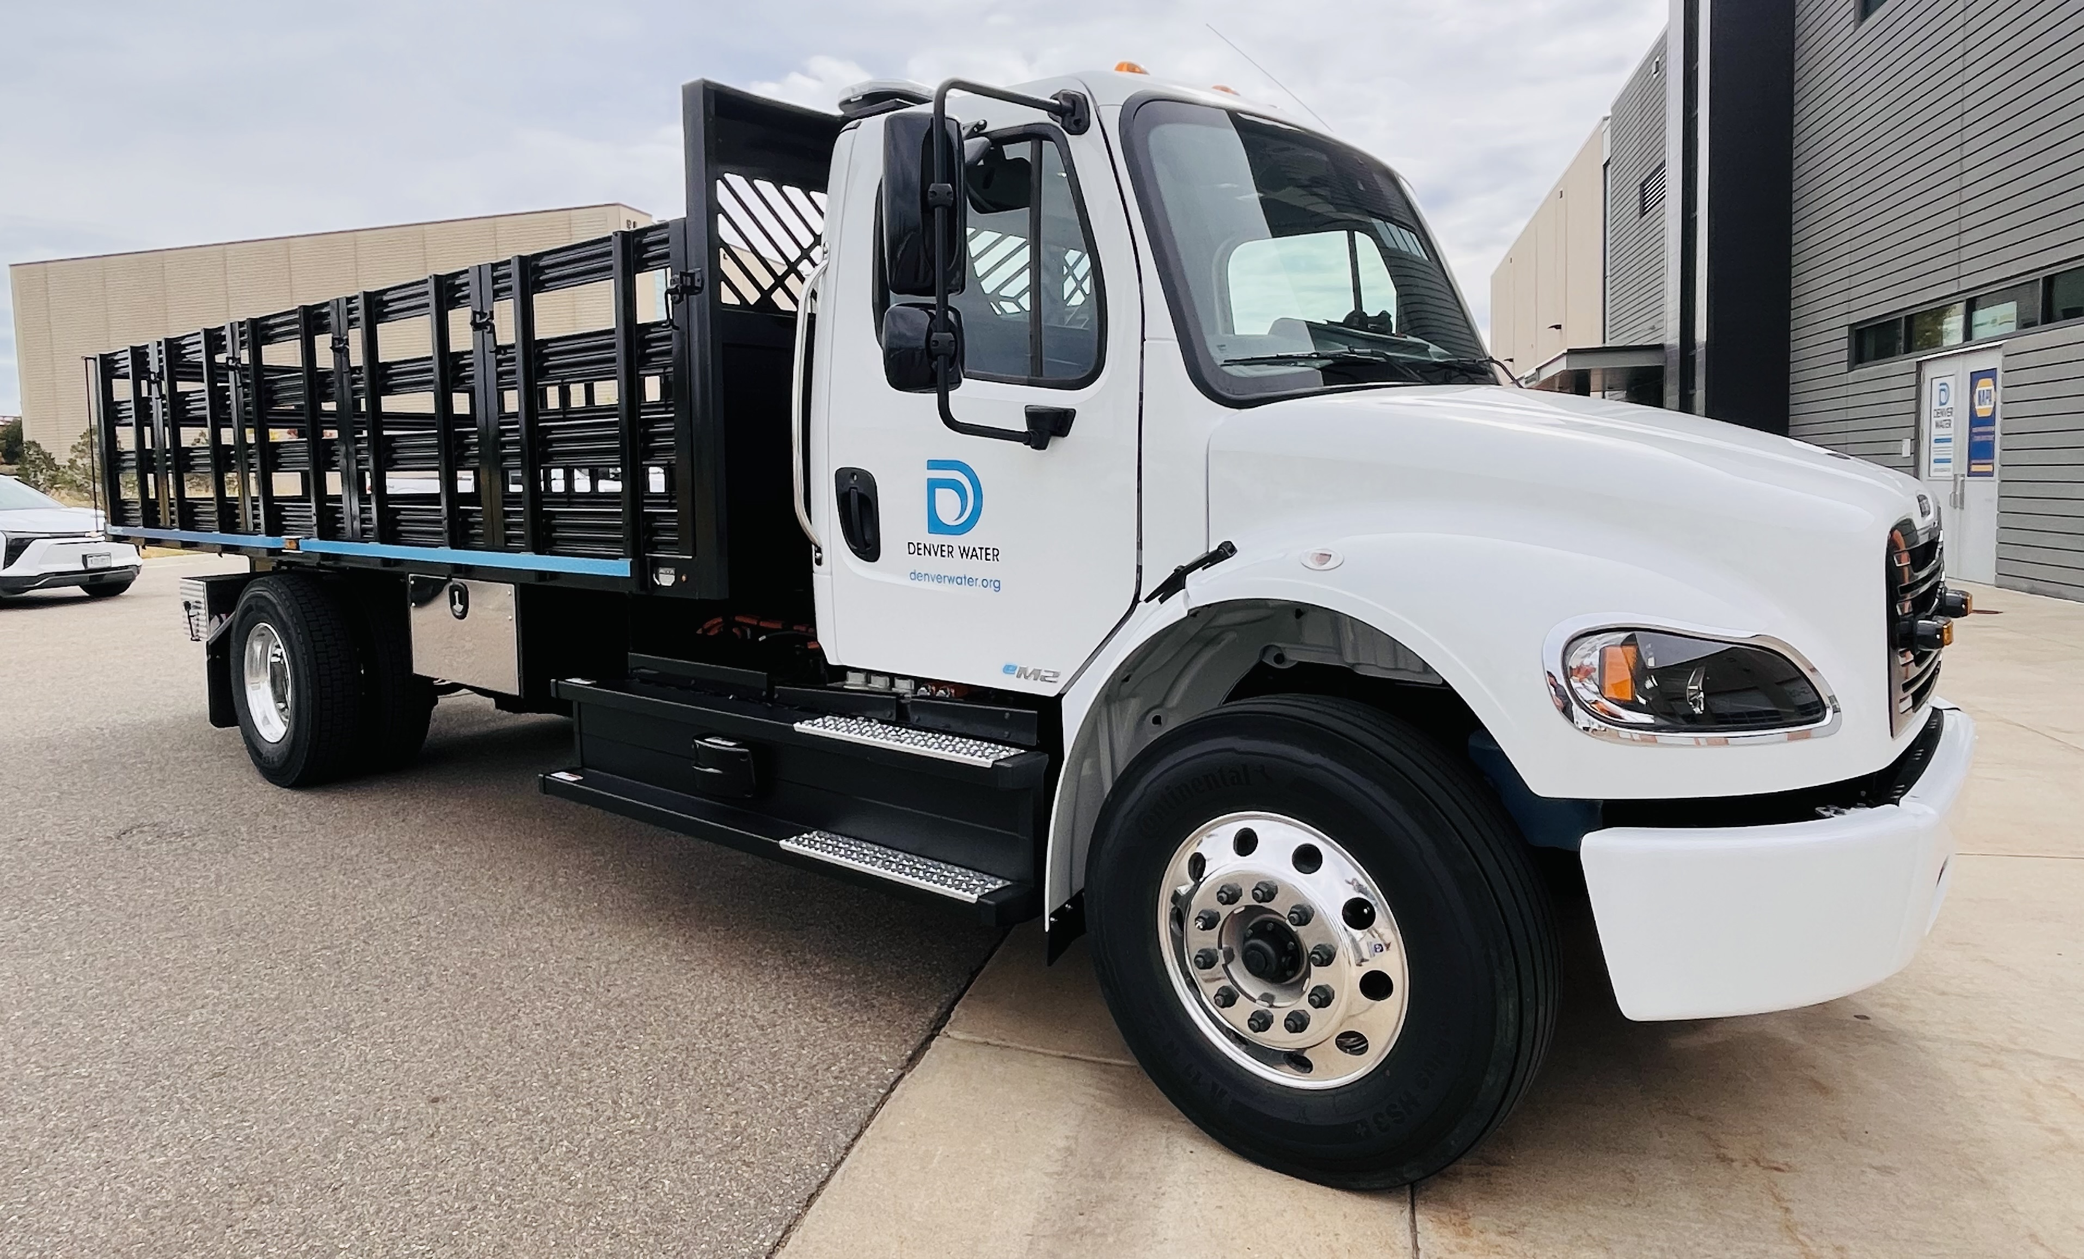
Fleet Overview
Over 800 total assets, including yellow iron, heavy equipment, generators, trailers, and vehicles.
Included 490 vehicles in our analysis with Sawatch Labs.
Most vehicles at the time of the study were ¾ ton trucks.
Fleet team oversees the maintenance of vehicles at our main Operations Complex, in addition to strategic planning and purchasing of vehicles.
Telematics provided by GeoTab.

Slide 24
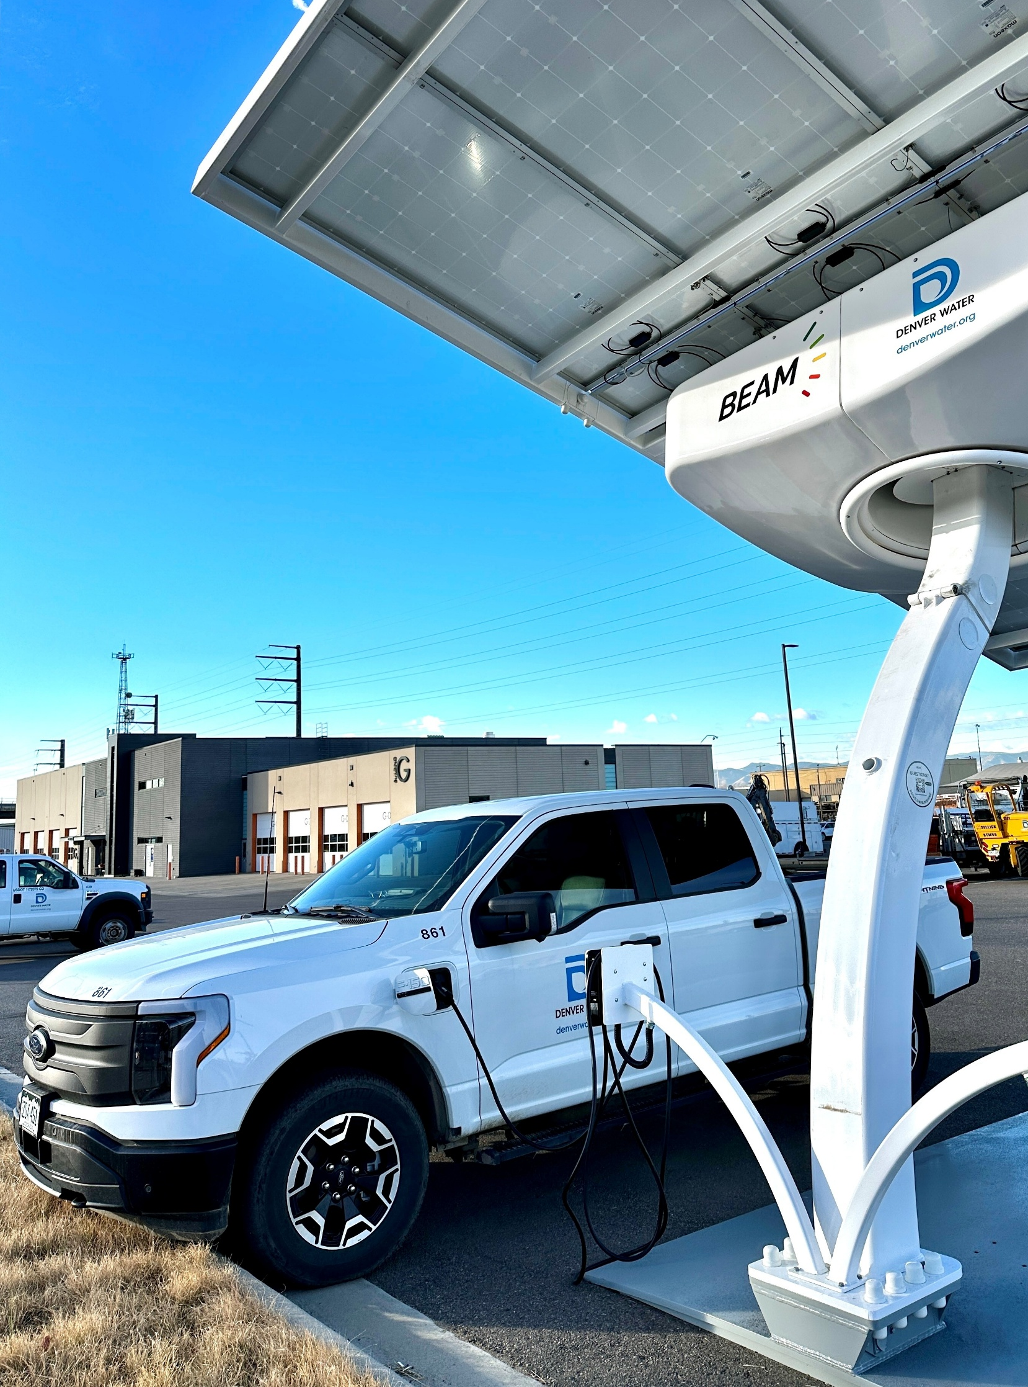
Specific Fleet Challenges
Elevation & weather conditions
Spread out operations
Unique upfit requirements for specific job functions (i.e. crane trucks, water trucks, etc.)
24/7 operations
Lack of existing infrastructure
Vehicle size vs. availability in the market

Slide 25
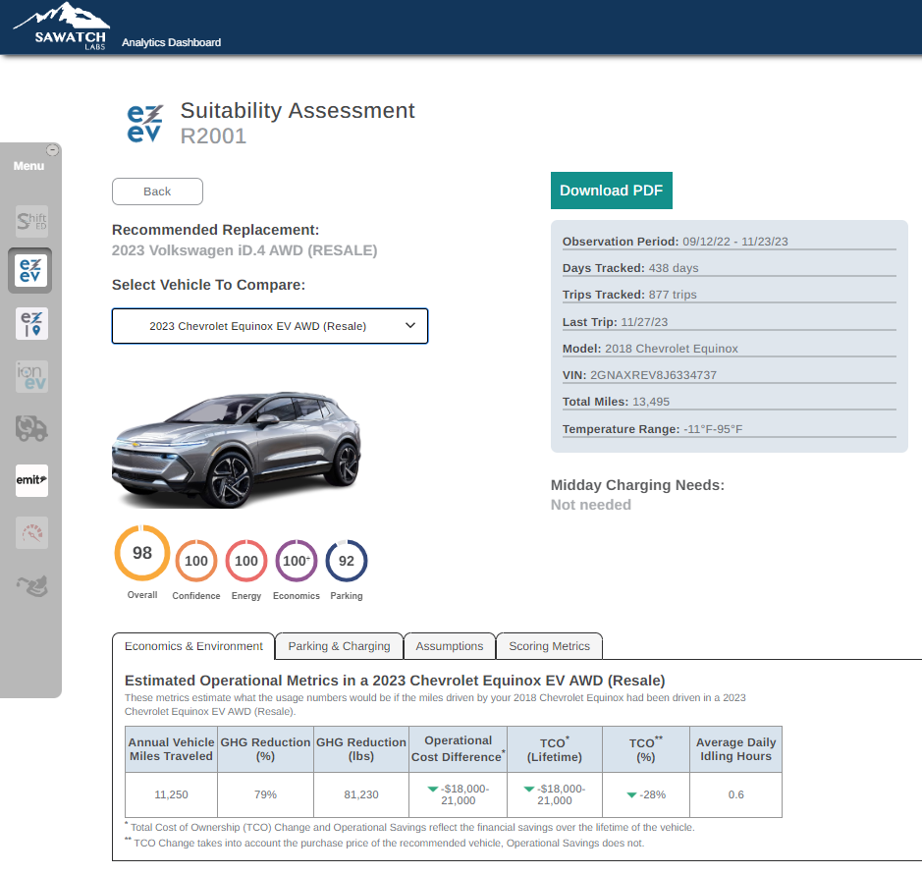
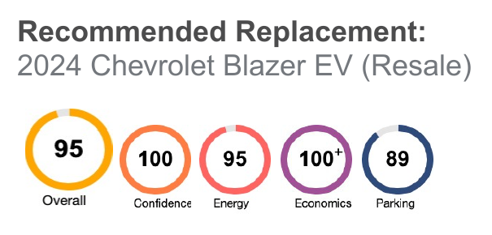
Benefits of Telematics Study
Creates buy-in from executives (ROI, costs, GHG savings)
Data-driven decisions for specific vehicles to ease driver anxiety
Strengthens grant funding proposals
Infrastructure planning and capital planning

Slide 26
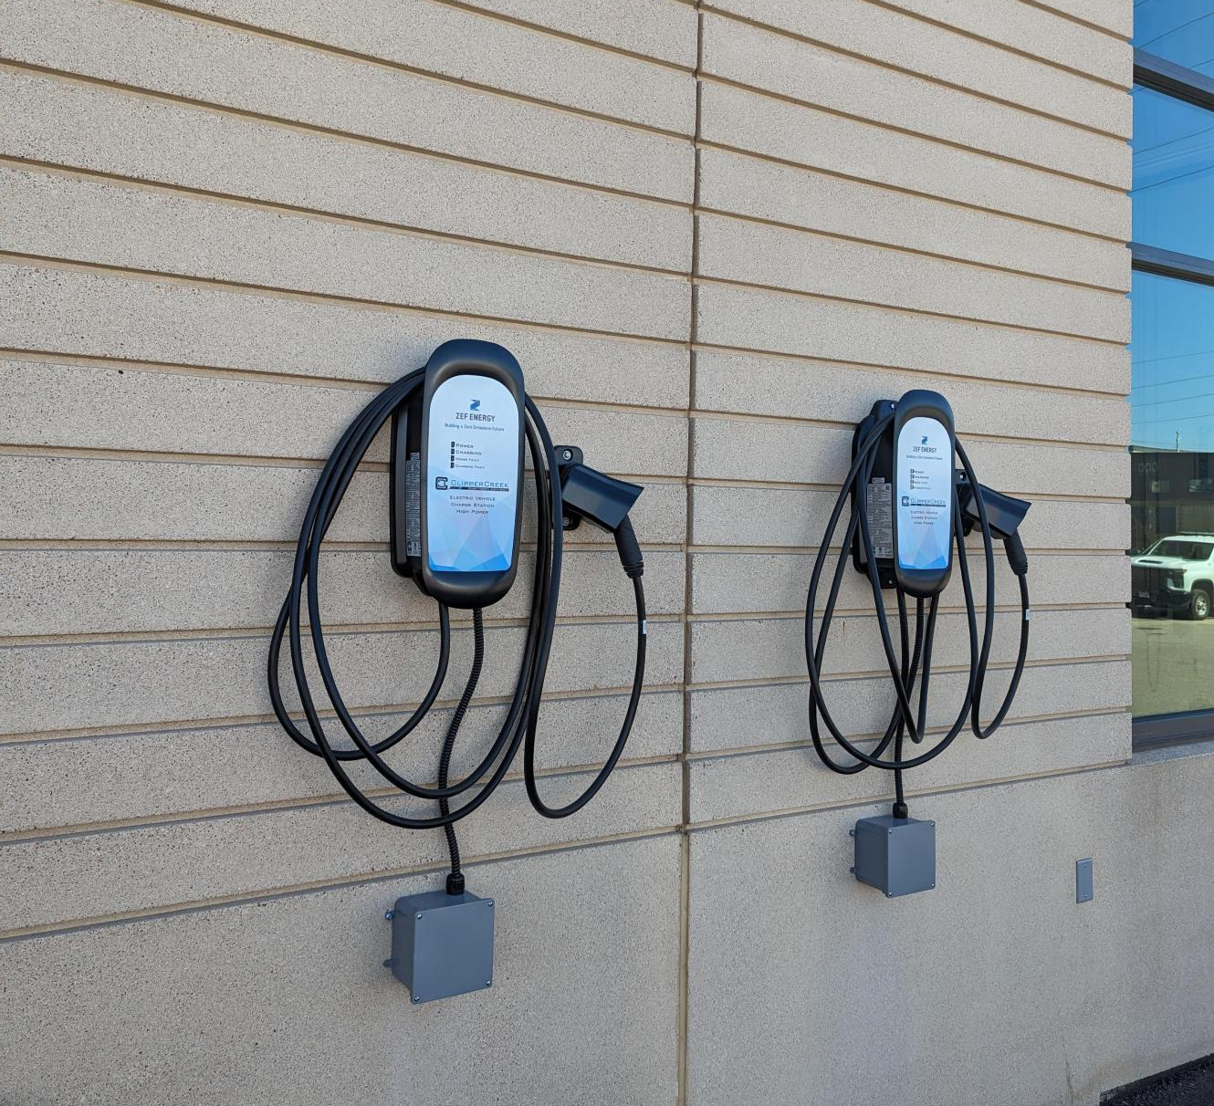
Implementing the Findings
Currently 40 EVs in the fleet; will be up to 60+ by the end of 2026.
First Class 6 EV truck in the state of Colorado.
Installation of Level 3 DC fast charger, 26 level 2 charging ports and 1 EV Arc BEAM charger.
Created road map for planned installations.

Slide 27
Lessons Learned
Successes
  Telematics data and reports helped us get buy-in from executives and funding for accelerated vehicle purchases.
  We used the study to launch our initial EV program and lean on outside expertise.
  Utilize funding if available; our study was 100% reimbursed by Xcel Energy through their Fleet Electrification Advisory Program (FEAP)
  GHG reporting is another important leverage tool to use from telematics.
Challenges
  Aligning capital planning, grant funding, and replacement cycles for the best outcomes and quick implementation.
  Competing capital projects and budget cuts.

Slide 28
Questions?
Katie Fletcher, Sustainability Program Analyst
Katie.fletcher@denverwater.org
Sustainability@denverwater.org

Slide 29

FLEET SERVICES division

Slide 30

Ronald Wirth
Fleet Advance Planning and Sustainability Manager
County of Sacramento, Fleet Services Division

Slide 31
EV Charging Infrastructure Planning using Telematics and Data Analytics

Slide 32
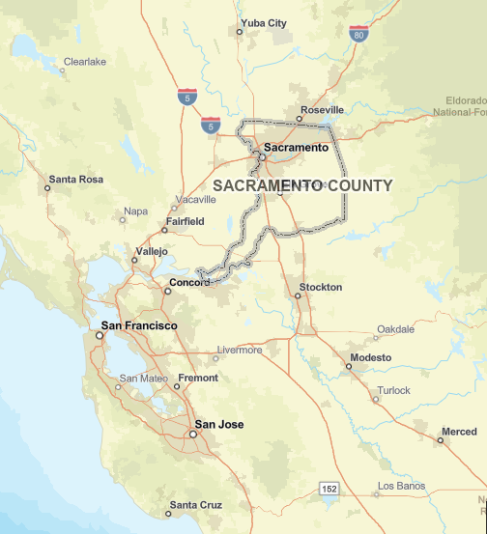
FLEET SERVICES DIVISION OVERVIEW
Area of Operation – 994 square miles
Population of over 1.6 million
Who We Serve –
Sacramento County Residents, Visitors, Businesses
24 Separate County Departments including –
Sheriff’s Department
Coroner
District Attorney
Animal Control and Regulation
Department of Transportation
Department of Water Resources
Department of Child, Family and Adult Services
Department of Waste Management and Recycling
Office of Emergency Services

Slide 33
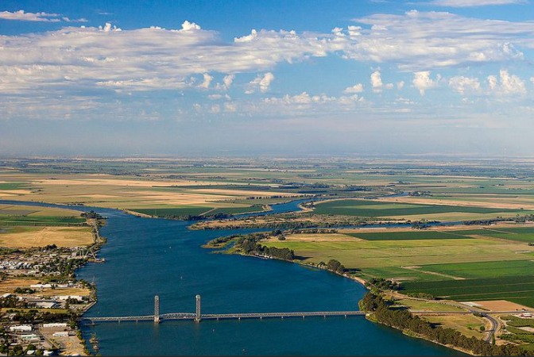

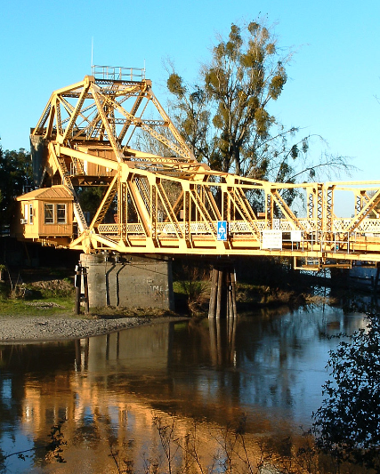
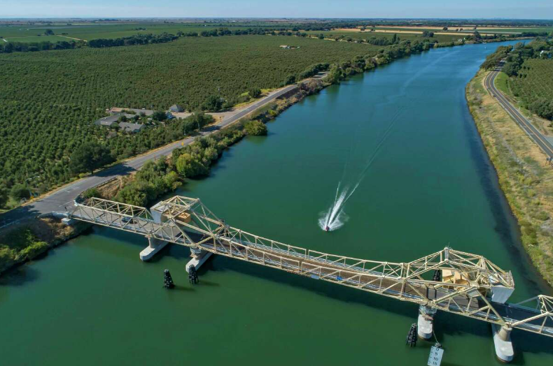
Sacramento delta

Slide 34
fleet services statistics
Over 2,800 fleet units, 73% Light, 22% Medium and Heavy, 5% Off Road
Approximately 460 Department Owned vehicles maintained by Fleet Services
Annual Fuel Usage – over 3.4M Gallons (all fuels)
Over 21 million miles traveled (VMT) in 2025
7 Maintenance Facilities
97 Total Fleet Employees
73 Technicians
ASE Blue Seal Certified
Fleet Services Division Chief
Light Equipment Fleet Manager
Heavy Equipment Fleet Manager
Fleet Advance Planning and Sustainability Manager
Specifications and Procurement Supervisor

Slide 35
Why electrify your fleet?
Organization / Executive Directive
Climate Action Plan Initiatives
Regulations
Greenhouse Gas Reduction
Reduce Fossil Fuel Consumption
Reduce Maintenance Costs
Marketing
The individual reasons you have chosen to electrify will drive the strategy and timeline of your overall electrification plan.

Slide 36
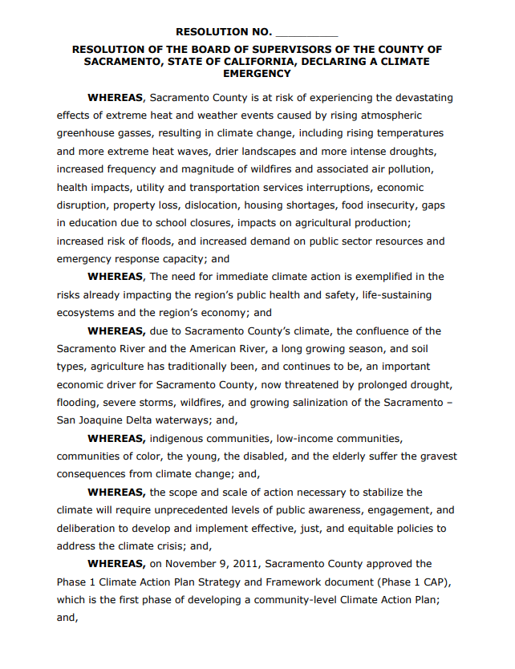
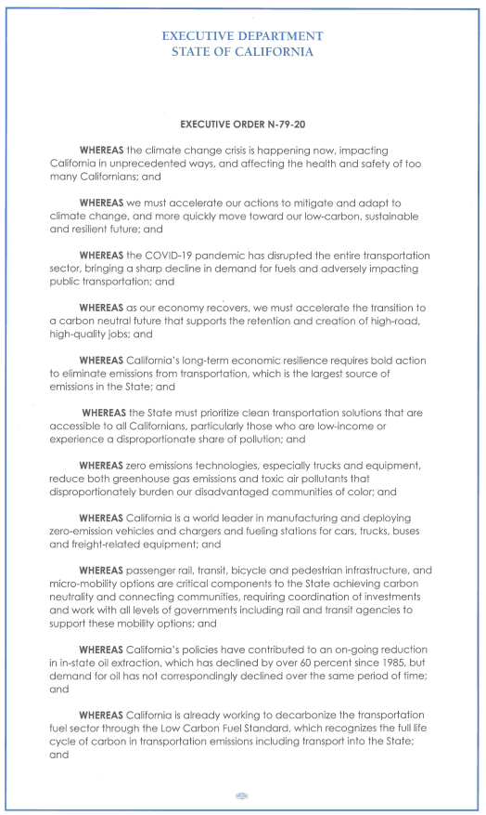


COUNTY INITIATIVES AND REGULATORY COMPLIANCE
2011 - Board of Supervisors adopted the Sacramento County Climate Action Plan (CAP) Strategy and Framework Document (Phase 1) to meet GHG reductions required by California’s Global Warming Solutions Act of 2006
2020 – County Board of Supervisors Climate Emergency Declaration
2020 – Executive Order N-79-20 signed by Governor Newsom
2022 – County Climate Action Plan Phase 2B
2024 – California Air Resources Board – Advanced Clean Fleets Regulation

Slide 37
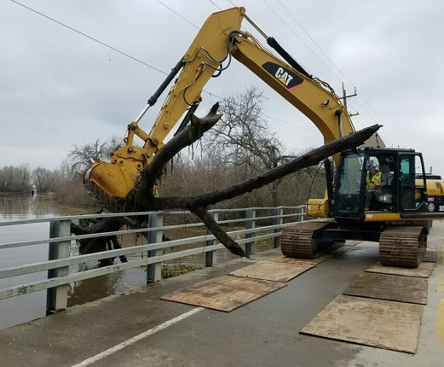
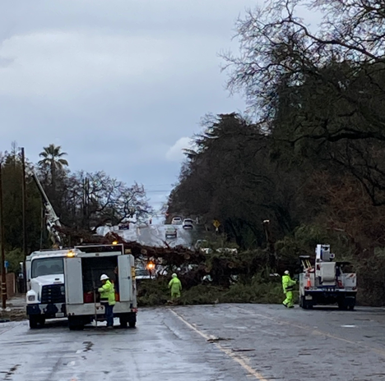
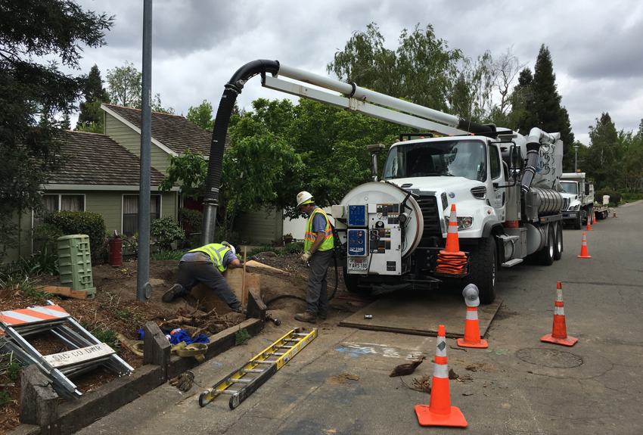
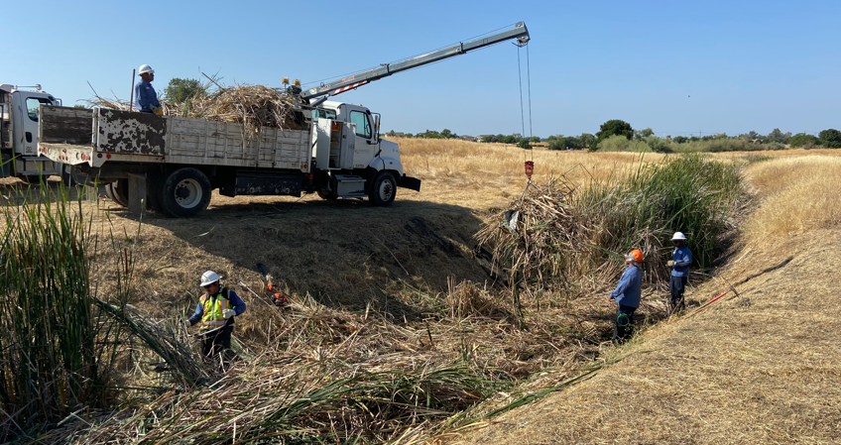
Every fleet is unique !
There is no “One Size Fits All” solution.
Assess Your Fleet - Size, Make Up, Geography, Climate, Parking Locations, Operational Challenges and Unique Operations
Talk to your vehicle / equipment operators. Review equipment needs with them. Visit job sites.

Slide 38
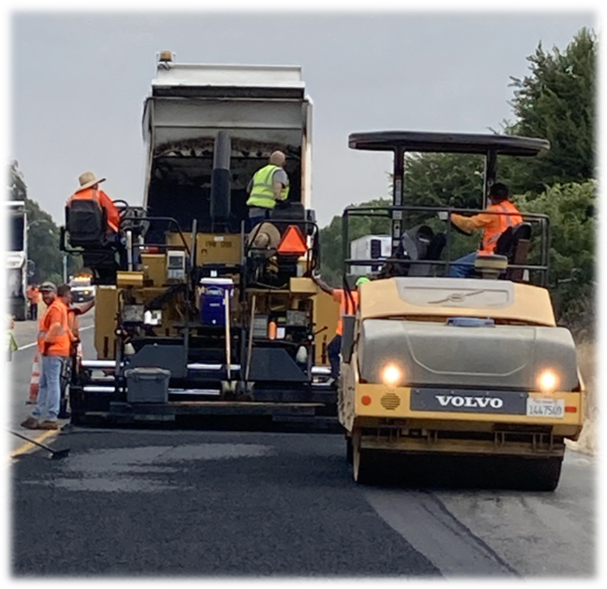
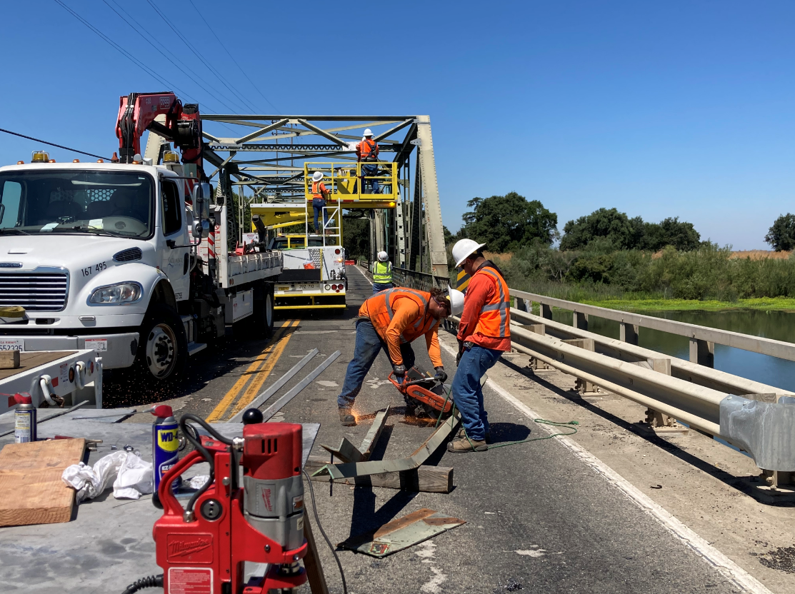

County crews and equipment in action

Slide 39
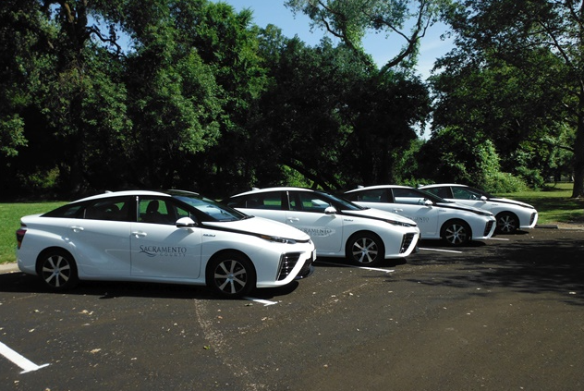
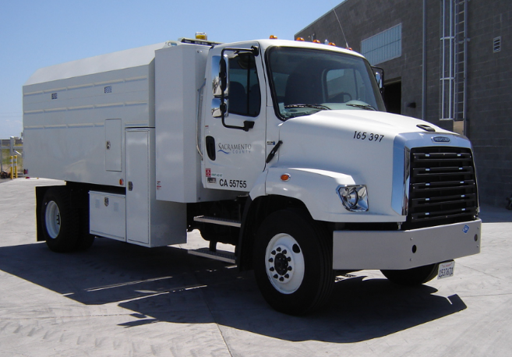
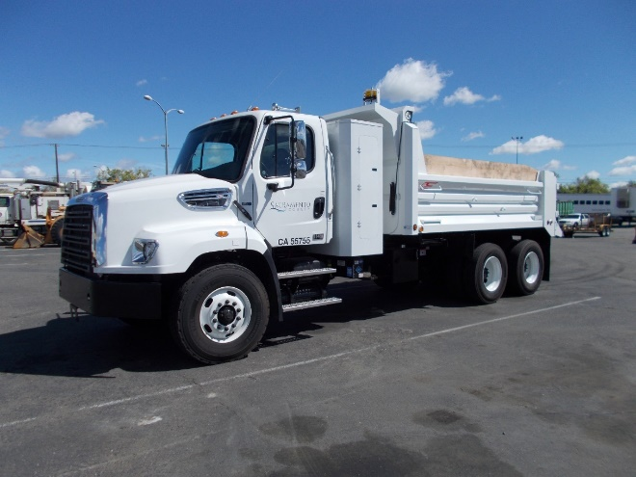
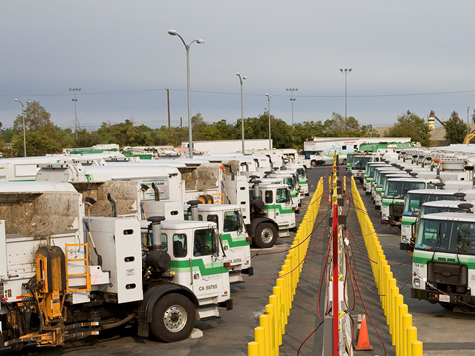
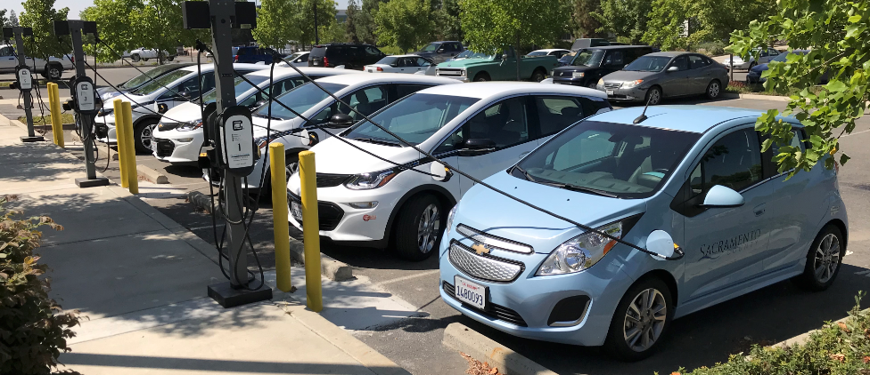
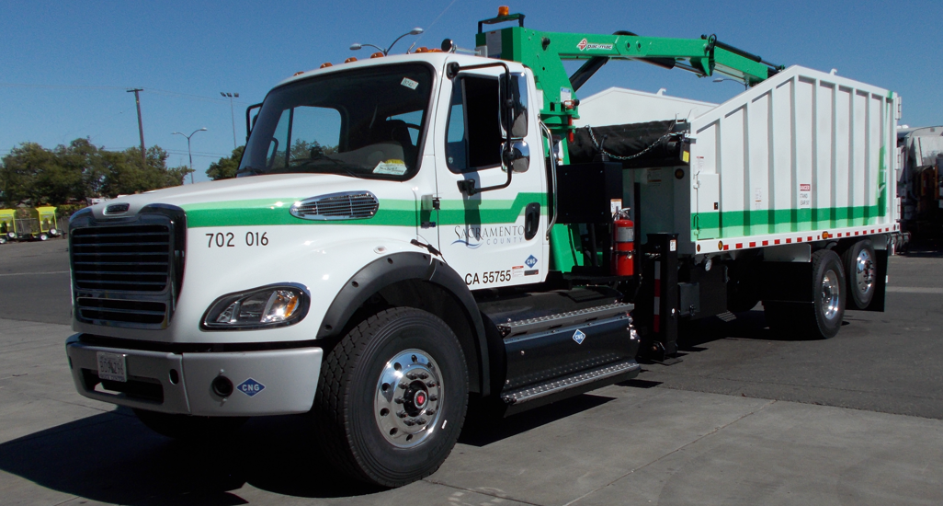
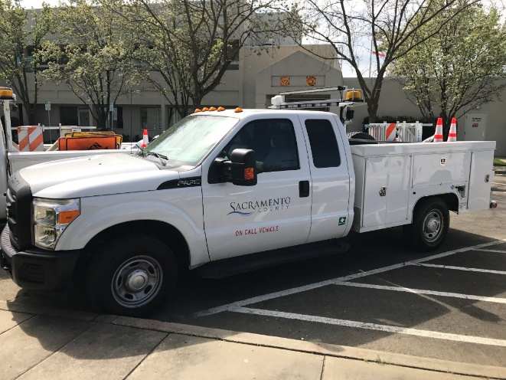
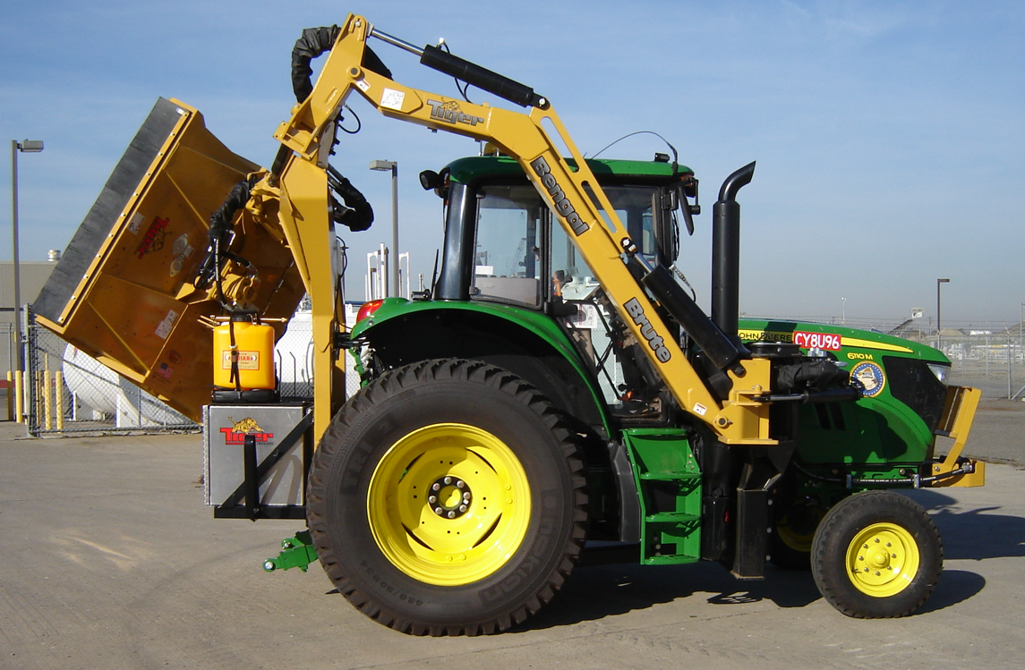

Slide 40
strategy
Light Fleet -
Passenger Cars
Pickups and Utility Trucks
Offsets Purchases for Heavy Fleet (CARB-ACF – California) – Vehicle Class Changes
Heavy Fleet -
CARB –ACF Compliance - Scheduled Purchases vs Milestone can heavily influence timelines
CARB Exemptions vs Internal Policies and Sustainability Goals
Contingency Plans – What do you do if there is no exemption, but also not suitable ZEV option?
Considerations –
Telematics – A must for informed, data driven decisions!
Utilization – Right Size the Fleet. Downsizing (where appropriate) can help free up capital for ZEV purchases.
Capital Cost Management and Budget – Long Term Forecasting.
Do vehicle lifecycles and replacement policy align with your electrification strategy?
Capital, Grants, Incentives for Charging Infrastructure – Who bears the cost of infrastructure?
Property – Owned or Leased?
Will your electrical utility be able to deliver capacity on your timeline?
Contingency Plan for Interim Charging?
Outside Consulting?

Slide 41
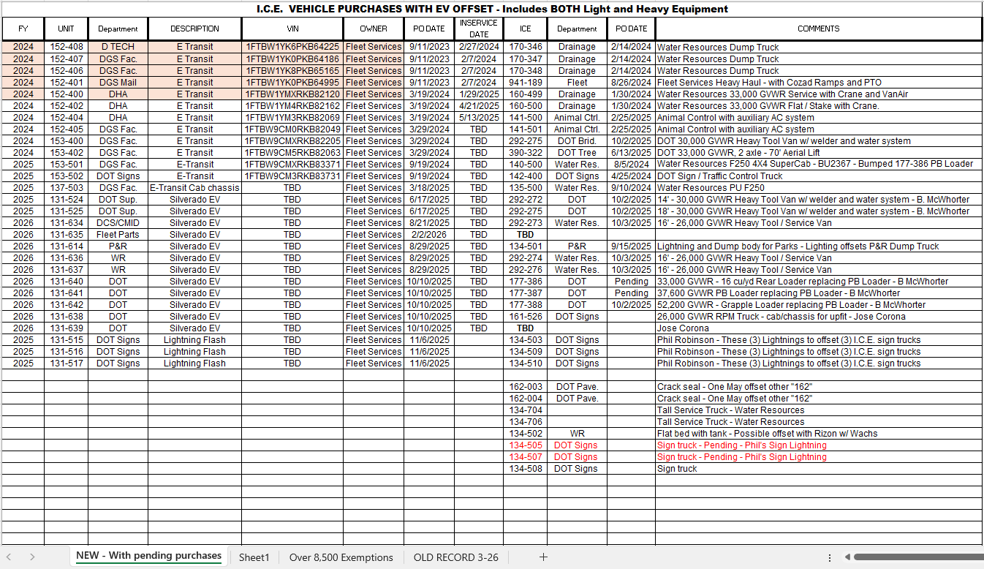
EV / ICE purchase tracking for carb -acf
NOTE: THIS IS A GENERAL ANALYSIS. Data shown does not represent an approved vehicle replacement plan. Actual implementation is likely to differ from the analysis shown.

Slide 42
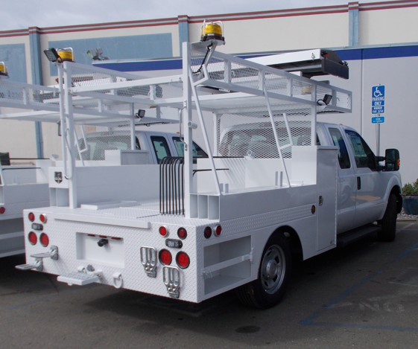
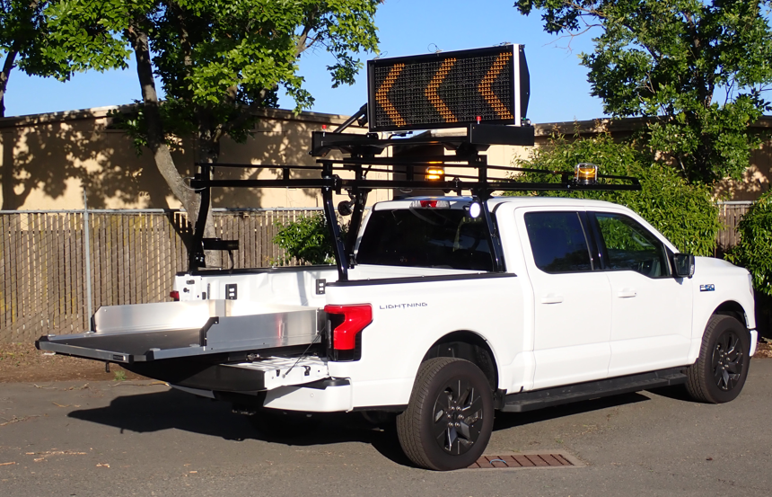
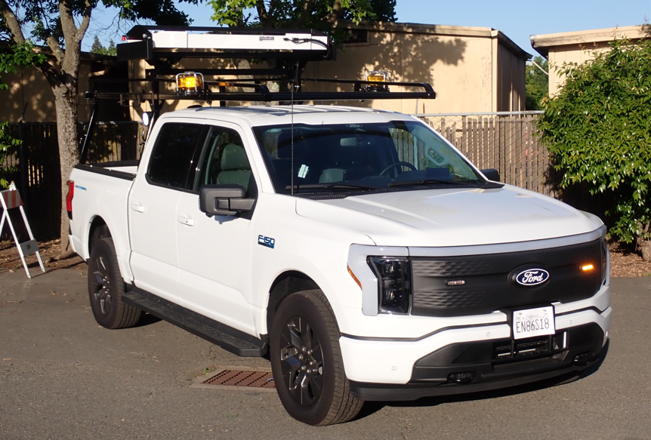

Slide 43
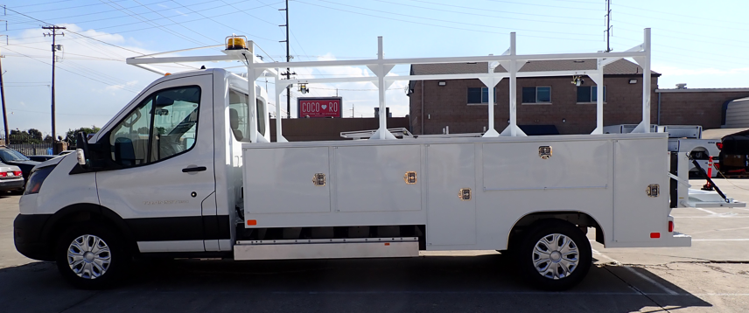
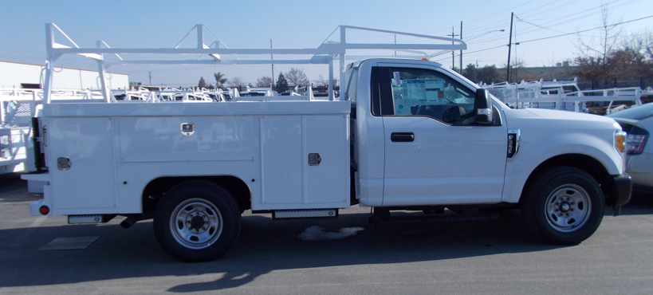



Slide 44
Maximize the benefits of your data
The Basics – Safety, PM Currency, PM Quality, Utilization, Unit Availability, Breakdown Rate, Technician Productivity and Efficiency, Accurate Data and Reporting.
Transportation Policy and Collective Bargaining -
Are your policies and agreements up to date?
Transportation, Authorized Use, Telematics, Utilization, Procurement, Lifecycles,
Home Retention, Right Sizing
KPI and Benchmarking – You cannot improve what you cannot measure!
Customer Communication and Surveys –
Are your priorities aligned with those of your customers?
Asset Management – Vehicle / Equipment Replacement Forecasting
Don’t wait for the perfect solution while operating inefficient / costly vehicles.
Collaboration and Communication – City Council, Board of Supervisors, Facilities Management, Real Estate Management, Budget / Accounting, Purchasing, Power Utility
Understand your organization’s Environmental / Sustainability Policies and Goals

Slide 45


Slide 46
GPS / Telematics BENEFITS
GPS / Telematics is the most efficient method to achieve data collection and reporting.
Regulatory Compliance - Smog checks without removing vehicles from service.
Clean Truck Check Program – Must use approved GPS provider. ECM and GPS cannot be disabled anytime during test period.
Advanced Clean Fleet – Exemption approval will require detailed daily data using telematics.
Emissions testing requirements for off-road equipment are expected from CARB soon.
Additional Benefits:
Safety – Speed Monitoring, Seat Belt Notification, Driver Behavior.
Vehicle Data in Real time – Utilization Data, Odometer Readings, Engine Hour Readings,
Emission Fault Notifications, Diagnostics Trouble Codes.
Efficiency – Smog Checks, Automatic Work Requests, avoids breakdowns and reduces down time.
Asset Management – Lifecycle Forecasting

Slide 47
IMPLEMENTATION OF GPS / Telematics in municipal fleets
Conduct Pilots to identify the system and supplier that works best for your application.
Identify Approval Levels - City Council, Board of Supervisors, Director
Transportation Policy
Bargaining Unit Notification / Meetings
Consult Purchasing – Identify Means to Purchase. State Contract, Co-Op Contract, Internal RFP. Include installation and extended subscription period.
Verify IT Systems and Fleet Management Information System (FMIS) Compatibility.
Set benchmarks for the parameters that are most valuable to your fleet. Safety, Fuel Consumption, Unauthorized Use, Routing, etc.

Slide 48

Parking location map

Slide 49

current location map

Slide 50


Trip data analysis
Telematics data using simple export to Excel
Average daily and maximum daily distances for one year.
Eliminates perceptions about daily miles driven.
Customize to distinct groups of vehicles where EV replacements are proposed.
Set Report Parameters to match the expected range of the proposed electric vehicle.
Expected range should account for varying conditions and battery degradation over time.
Identifies parking locations and dwell times to plan for charging.

Slide 51



Trip data analysis

Slide 52

Annual vehicle miles traveled by vehicle class
NOTE: THIS IS A GENERAL ANALYSIS. Data shown does not represent an approved vehicle replacement plan. Actual implementation is likely to differ from the analysis shown.

Slide 53

Annual vehicle miles traveled by vehicle class
NOTE: THIS IS A GENERAL ANALYSIS. Data shown does not represent an approved vehicle replacement plan. Actual implementation is likely to differ from the analysis shown.

Slide 54

Annual fuel consumption
NOTE: THIS IS A GENERAL ANALYSIS. Data shown does not represent an approved vehicle replacement plan. Actual implementation is likely to differ from the analysis shown.

Slide 55

Annual fuel consumption - continued
NOTE: THIS IS A GENERAL ANALYSIS. Data shown does not represent an approved vehicle replacement plan. Actual implementation is likely to differ from the analysis shown.

Slide 56
FLEET VEHICLE REPLACEMENT FORECASTING
    Facilitates Regular and Scheduled Replacement of Fleet Vehicles on a pre-determined life cycle.
    Long Term Budget Planning.
    Maintains Average Fleet Age – Current Avg. Age – 5.1 years.
    Minimizes Maintenance and Operating Costs.
    Customizable for Specific Vehicle Classes.
    Allows for infrastructure planning.
    Use of these management tools has been beneficial in largely eliminating overdue replacement vehicles which will allow a strategic transition to Zero Emission and EV to meet sustainability goals and regulations.

Slide 57

LONG TERM REPLACEMENT FORECAST
NOTE: THIS IS A GENERAL ANALYSIS. Dollar amounts and data shown do not represent an approved budget or replacement plan. The chart shown is an example of the capabilities of this tool for analytical purposes

Slide 58

LONG TERM REPLACEMENT FORECAST
NOTE: THIS IS A GENERAL ANALYSIS. Dollar amounts and data shown do not represent an approved budget or replacement plan. The chart shown is an example of the capabilities of this tool for analytical purposes.

Slide 59

Department owned REPLACEMENT FORECAST
NOTE: THIS IS A GENERAL ANALYSIS. Dollar amounts and data shown do not represent an approved budget or replacement plan. The chart shown is an example of the capabilities of this tool for analytical purposes

Slide 60

ev transition FORECAST – LIGHT EQUIPMENT
NOTE: THIS IS A GENERAL ANALYSIS.
Dollar amounts and data shown do not represent an approved budget or replacement plan. The chart shown is an example of the capabilities of this tool for analytical purposes

Slide 61

Ev charging projection – EXAMPLE 1
NOTE: THIS IS A GENERAL ANALYSIS. Data shown does not represent an approved vehicle replacement plan. Actual implementation is likely to differ from the analysis shown.

Slide 62

Ev charging projection – EXAMPLE 2
NOTE: THIS IS A GENERAL ANALYSIS. Data shown does not represent an approved vehicle replacement plan. Actual implementation is likely to differ from the analysis shown.

Slide 63

ev transition FORECAST – HEAVY EQUIPMENT
NOTE: THIS IS A GENERAL ANALYSIS.
Dollar amounts and data shown do not represent an approved budget or replacement plan. The chart shown is an example of the capabilities of this tool for analytical purposes

Slide 64



FORECASTING ELECTRIC VEHICLE COST
BY VEHICLE TYPE – light equipment
  Passenger Cars and Light Pickups
    Passenger cars and trucks are being manufactured currently. Availability has been limited for fleet type vehicles.
    Retail, Wholesale, CoOp Contracts, State Contract pricing is known.
    Estimates and Assumptions can be made based on current models, manufacturer pricing, and accounting for inflation.
    Manufacturer’s are discontinuing many fleet trim levels for more profitable higher trim levels.

Slide 65



FORECASTING ELECTRIC VEHICLE COST
BY VEHICLE TYPE – heavy equipment
  Heavy Duty Trucks
    Currently suitable EV truck chassis are not available to build most County medium and heavy municipal service trucks. Available configurations do not allow for service body installations.
    Weight of electric chassis are much heavier. Batteries / Components occupy frame space.
    Most heavy manufacturers are not at scaled production for vocational trucks.
    Many aftermarket and EV startups – one or more may fill the void but cost is currently unknown.
    Fleet cost assumptions are based on models for which manufacturers have advertised retail pricing.
    County heavy municipal trucks require major upfit. Cost increase is not a straight percentage increase.
    Regulatory compliance strategies often involve a change in vehicle class, or a purchase of an EV in a lighter vehicle class to offset a purchase of an ICE heavy truck that cannot yet be electrified.

Slide 66

Electric Vocational truck COSt estimating
  Example:
  County of Sacramento heavy service truck. Total cost in this example was 40% chassis and 60% body and upfit.
  Total cost of truck shown in 2018 - $222,735
  Estimate for diesel replacement in 2028 –
  $400,923
Estimate to Convert to EV:
Chassis Cost 40% = $160,370 X 300% (Convert to EV) = $481,108
Body and Upfit 60% = $240,554 Equivalent Body and Upfit = $240,554
= $721,662
Net Increase in this example is 80.0%

Slide 67


Slide 68

Use of grants and incentives
    Assess Grant / Incentive Requirements
    Does it meet your use case?
    Are there restrictions? Fleet vs Public use? Regulatory Restrictions?
    Can you meet the timelines?
    Long Term Obligations – Data Collection and Reporting?
    Do you have the resources (hardware, software, personnel) to meet requirements?
    Does the benefit outweigh the costs of complying with grant requirements?
    Who will draft the grant application?
    Can you make a competitive business case compared to other applicants?
    Pre-Planned and /or Permitted Projects are an Advantage
      A “Shovel Ready” project is a huge advantage in meeting grant / incentive application deadlines.

Slide 69

Infrastructure planning and development

Slide 70

How do you make sense of it all?
    Data, Data, Data!
    Process improvement
    Internal Reporting
    Fleet Performance Measures and KPIs
    Understand your Fleet and Your Customers - Communication
    Identify “Low Hanging Fruit”
    Regulatory Compliance – Identify where compliance intersects other fleet initiatives.
    Where is the most fuel consumed?
    What alternatives are available?
    The cleanest gallon of fuel is the gallon that is never consumed!
    Third Party Consulting
      Fleet Analysis and EV Transition Implementation Plan
      Facility Assessment, Energy Modeling, Retrofit, Charging Infrastructure Plan
      Grant Writer

Slide 71
Ronald Wirth
Fleet Advance Planning and Sustainability Manager
County of Sacramento, Fleet Services Division
WirthR@SacCounty.Gov

Slide 72
Discussion
Jared Walker
Sr. Specialist, EV Product Analytics
Sawatch Labs, A WEX Company
Katie Fletcher
Sustainability Program Analyst
Denver Water
Ronald Wirth
Fleet Advance Planning and Sustainability Manager
County of Sacramento, Fleet Services Division

Slide 73

Thank you!
Notes:
Replace Leaf logo with your images

Slide 74
Feb. 26 Cybersecurity and Fleet Technology: Identifying Vulnerabilities
March 19 Law Enforcement Vehicle Options
May 20 Using Telematics Data Analytics to Plan for Fleet Electrification
July 16 Preparing for Natural Disasters
Sept. 17 Lower Cost Charging options
Dec. 10 Upfitting Your Garage for Electric and Alternative Fuel Vehicles
View Recordings of Previous Webinars
go.ncsu.edu/sft-webinars
2026 WEBINAR SCHEDULE
Notes:
And don’t forget to join us for the remaining SFT Webinars this year or checkout recordings.

